Slide 1
Introduction to ML
Rahul Aralikatte

Slide 2






About me

Slide 3
Traditional Programming
Machine Learning
Input
Input
Computer
Output
Computer
Program
Program
Output
Input | a=2, b=3
Program | a+b
Output | 5
Input | a=2, b=3
Output | 10
Program | 2a+2b
We will need multiple such
(input, output) pairs

Slide 4
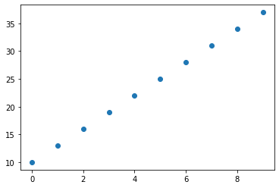
Example
X | 0 | 1 | 2 | 3 | 4 | 5 | 6 | 7 | 8 | 9
Y | 10 | 13 | 16 | 19 | 22 | 25 | 28 | 31 | 34 | 37
What is the program which can
take in X and produce Y?

Slide 5
Example
Algorithm:
Make an initial guess for m and c
Let us take m=0 and c=0
Make a prediction and compute the error
y’ = 0 * 2 + 0
y’ = 0
But we want y=16
error (E) = (0-16)² = 256
If we make a small change to m and c, will will get a smaller error?
Let us add 0.01 to both m and c
y_m = 0.01 * 2 + 0 = 0.02
y_c = 0 * 2 + 0.01 = 0.01
new_error_m = (0.02-16)² = 255.36
new_error_c = (0.01-16)² = 255.68
We will get a better y’ if we add a small delta to both m and c
X | 0 | 1 | 2 | 3 | 4 | 5 | 6 | 7 | 8 | 9
Y | 10 | 13 | 16 | 19 | 22 | 25 | 28 | 31 | 34 | 37

Slide 6
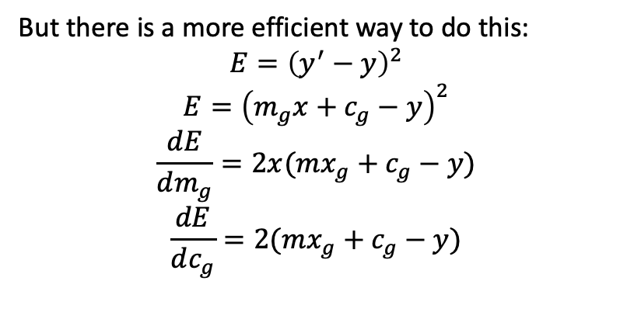
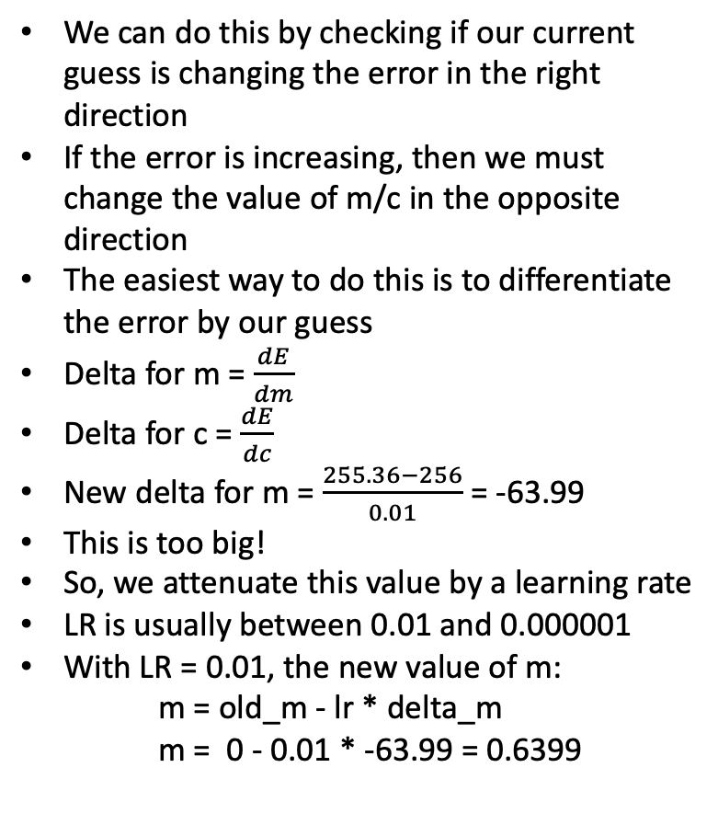
Example
How to decide the deltas?
We can do this by checking if our current guess is changing the error in the right direction
If the error is increasing, then we must change the value of m/c in the opposite direction
The easiest way to do this is to differentiate the error by our guess
Delta for m = $\frac{dE}{dm}$
Delta for c = $\frac{dE}{dc}$
New delta for m = $\frac{255.36−256}{0.01}$ = -63.99
This is too big!
So, we attenuate this value by a learning rate
LR is usually between 0.01 and 0.000001
With LR = 0.01, the new value of m:
m = old_m - lr * delta_m
m = 0 - 0.01 * -63.99 = 0.6399
But there is a more efficient way to do this:
$$E={\left(y^{′}−y\right)}^{2}$$
$$E={\left(m_{g}x+c_{g}−y\right)}^{2}$$
$$\frac{dE}{dm_{g}}=2x(mx_{g}+c_{g}−y)$$
$$\frac{dE}{dc_{g}}=2(mx_{g}+c_{g}−y)$$
Known as squared error
Let’s see this in action!
Known as gradient descent

Slide 7
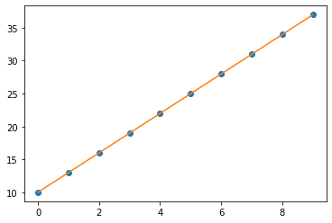
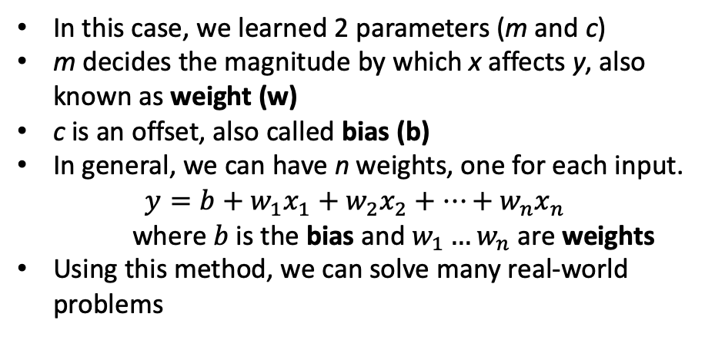
In this case, we learned 2 parameters (m and c)
m decides the magnitude by which x affects y, also known as weight (w)
c is an offset, also called bias (b)
In general, we can have n weights, one for each input.
$$y={b+w}_{1}x_{1}+w_{2}x_{2}+…+w_{n}x_{n}$$
where $b$is the bias and $w_{1}…w_{n}$ are weights
Using this method, we can solve many real-world problems
This is called Linear Regression
Area (m²) | Location | # of rooms | # of floors | Basement | Price
2000 | Jayanagar | 3 | 2 | Yes | 3,00,00,000
2500 | R.R.Nagar | 4 | 2 | No | 2,70,00,000
1800 | J.P.Nagar | 2 | 1 | No | 1,80,00,000

Slide 8
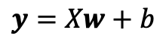
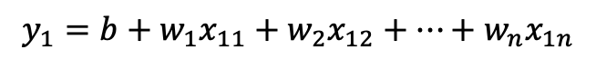
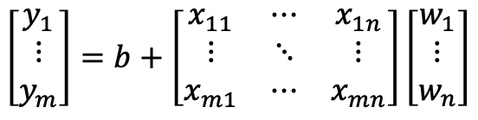
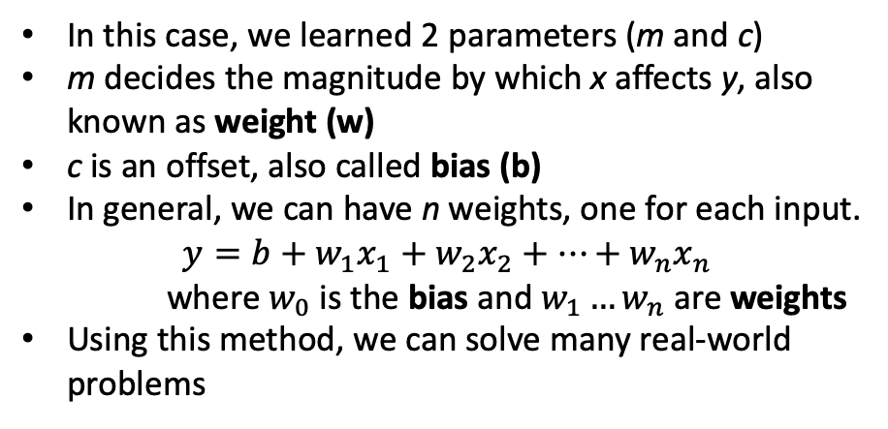

Is there a better way to denote this?
In this case, we learned 2 parameters (m and c)
m decides the magnitude by which x affects y, also known as weight (w)
c is an offset, also called bias (b)
In general, we can have n weights, one for each input.
$$y={b+w}_{1}x_{1}+w_{2}x_{2}+…+w_{n}x_{n}$$
where $w_{0}$ is the bias and $w_{1}…w_{n}$ are weights
Using this method, we can solve many real-world problems
$$y_{1}={b+w}_{1}x_{11}+w_{2}x_{12}+…+w_{n}x_{1n}$$
$$y_{2}={b+w}_{21}x_{1}+w_{2}x_{22}+…+w_{n}x_{2n}$$
$$…$$
$$y_{m}={b+w}_{1}x_{m1}+w_{2}x_{m2}+…+w_{n}x_{mn}$$
$$\left[\begin{aligned}y_{1} \\ ⋮ \\ y_{m}\end{aligned}\right]=b+\left[\begin{matrix}x_{11} & ⋯ & x_{1n} \\ ⋮ & ⋱ & ⋮ \\ x_{m1} & ⋯ & x_{mn}\end{matrix}\right]\left[\begin{aligned}w_{1} \\ ⋮ \\ w_{n}\end{aligned}\right]$$
Area (m²) | Location | # of rooms | # of floors | Basement | Price
2000 | Jayanagar | 3 | 2 | Yes | 3,00,00,000
2500 | R.R.Nagar | 4 | 2 | No | 2,70,00,000
1800 | J.P.Nagar | 2 | 1 | No | 1,80,00,000
$$y=Xw+b$$
Equation for linear regression!

Slide 9
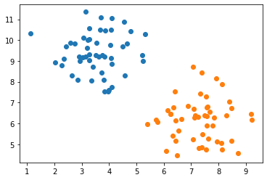
What if…
Mass | Density | Will float?
3.27 | 9.32 | No
8.40 | 7.04 | Yes
3.20 | 9.62 | No
8.14 | 7.88 | Yes
7.55 | 7.29 | Yes
Instead of a real valued output, we need a yes or no answer
This is a (binary) classification problem
How can we apply what we have learned so far?

Slide 10

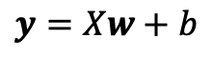
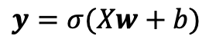
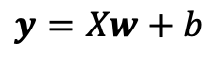
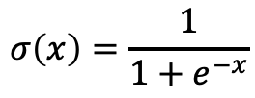
Regression→Classification
We know:
We can decide a threshold (t) for y. Anything below/above t will be class 0/1
How do we decide the threshold (t)?
$$y=Xw+b$$
We need to convert a real number output to a binary class.
Can we do something smart to overcome this?
Now, we can forget about t (which will usually be 0.5)
Therefore, we can use the regression equation to solve a classification problem by,
$$σ\left(x\right)=\frac{1}{1+e^{−x}}$$
$$y=Xw+b$$
$$y=σ(Xw+b)$$
Sigmoid or logistic
function
Logistic Regression!

Slide 11
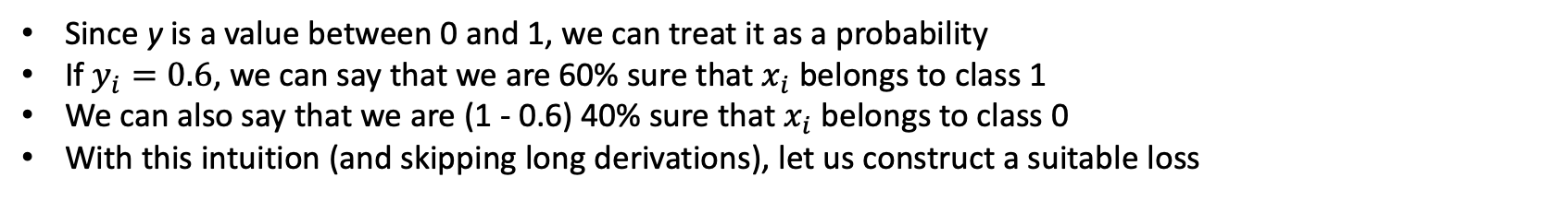
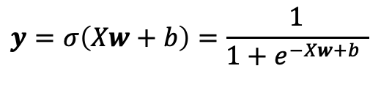
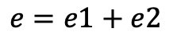
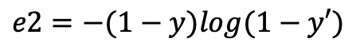
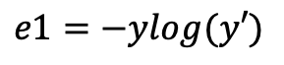
Loss and Gradients
Logistic Regression:
$$y=σ\left(Xw+b\right)=\frac{1}{1+e^{−Xw+b} }$$
Since y is a value between 0 and 1, we can treat it as a probability
If $y_{i}=0.6$, we can say that we are 60% sure that $x_{i}$ belongs to class 1
We can also say that we are (1 - 0.6) 40% sure that $x_{i}$ belongs to class 0
With this intuition (and skipping long derivations), let us construct a suitable loss
$$e1=−ylog(y′)$$
$$e2=−(1−y)log(1−y′)$$
$$e=e1+e2$$
Y | Y’ | Loss
0 | 0 | Low
0 | 1 | High
1 | 0 | High
1 | 1 | Low
Y | Y’ | log(Y’) | e1
0 | 0 | -inf | 0*
0 | 1 | 0 | 0
1 | 0 | -inf | inf
1 | 1 | 0 | 0
Y | Y’ | 1-Y | log(1-Y’) | e2
0 | 0 | 1 | 0 | 0
0 | 1 | 1 | -inf | inf
1 | 0 | 0 | 0 | 0
1 | 1 | 0 | -inf | 0*
Y | Y’ | e1 | e2 | e
0 | 0 | 0 | 0 | 0
0 | 1 | 0 | inf | inf
1 | 0 | inf | 0 | inf
1 | 1 | 0 | 0 | 0
* for convenience

Slide 12
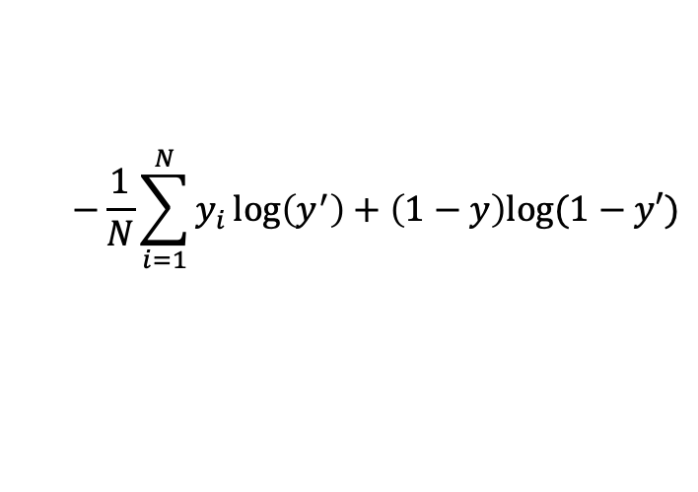
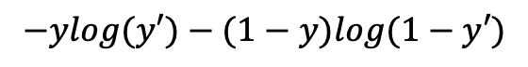
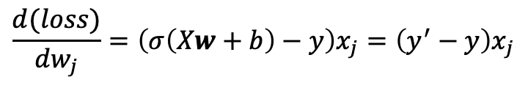
Loss and Gradients
Loss for 1 example:
$$−ylog(y′)−(1−y)log(1−y′)$$
$$−ylog(σ(Xw+b))−(1−y)log(1−σ(Xw+b))$$
$$−\frac{1}{N}\sum_{i=1}^{N}{y_{i}\log\left(y^{′}\right)+\left(1−y\right)log⁡(1−y′)}$$
Loss for N examples:
To get the gradient of the loss, we differentiate it w.r.t. to weights w
In other words, we change the values of w which would result in reduction of loss
Turns out, all gradients are of the form
$$\frac{d(loss)}{dw_{j}}=\left(σ\left(Xw+b\right)−y\right)x_{j}=\left(y^{′}−y\right)x_{j}$$
Now let’s see logistic regression in action!

Slide 13
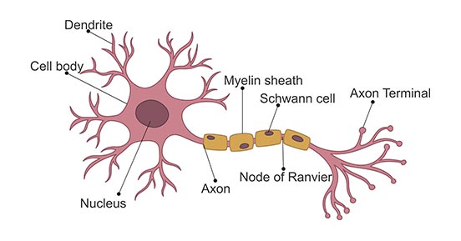
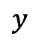
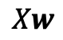
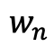

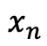
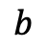
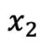
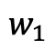
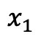
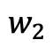

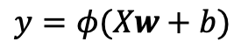
Neuron
Real Neuron
Artificial Neuron
$$x_{1}$$
$$w_{1}$$
$$w_{2}$$
$$y$$
$$x_{2}$$
$$Xw$$
$$φ$$
$$⋮$$
$$w_{n}$$
$$b$$
$$x_{n}$$
$$y=φ(Xw+b)$$
Logistic Regression $≡$ Single Neuron $≡$ Perceptron

Slide 14
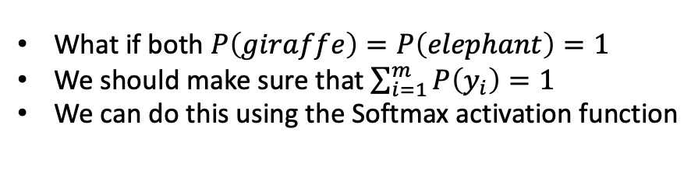
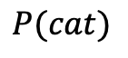

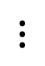
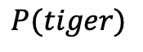
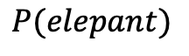
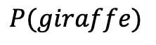
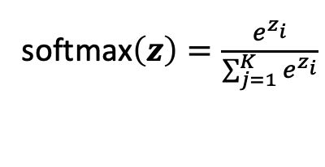
Multi-Class Classification
Suppose we want to identify animals based on their weight, height, and dietary habits
Height | Weight | Herbivore? | Class
30.0 | 5.0 | Yes | 0
300.0 | 700 | Yes | 1
0.5 | 0.01 | No | 2
$$P(cat)$$
$$⋮$$
height
$$P(giraffe)$$
What if both $P\left(giraffe\right)=P\left(elephant\right)=1$
We should make sure that $\sum_{i=1}^{m}{P\left(y_{i}\right)=1}$
We can do this using the Softmax activation function
weight
$$P(elepant)$$
diet
softmax$\left(z\right)=\frac{e^{z_{i}}}{\sum_{j=1}^{K}{e^{z_{i}}}}$
$$P(tiger)$$
$$⋮$$
Remember: all other steps remain the same!

Slide 15
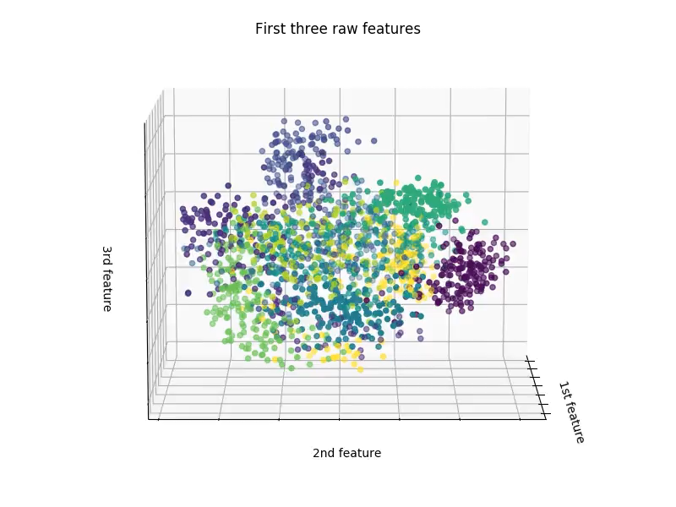
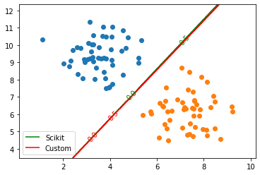
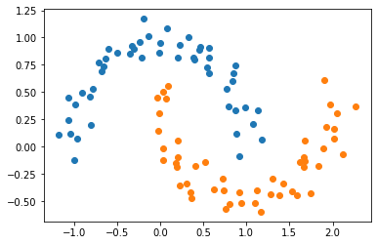
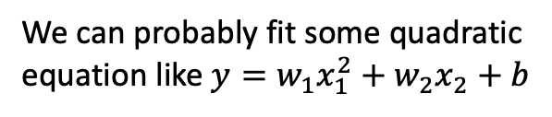
Is this enough?
We can now solve linearly separable problems
Data is said to be linearly separable if n-dimensional data can be perfectly separated with a n-1 dimensional hyperplane
But what about this data?
We can probably fit some quadratic
equation like $y=w_{1}x_{1}^{2}+w_{2}x_{2}+b$
We need a way to make non-linear data linearly separable

Slide 16
Feature Extraction
Art of converting
into
Any ML/DL model will have the form
Input
Feature Extractor
Linear Separator
Output
This requires at least
2 full courses!
We have talked
about this till now

Slide 17
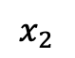
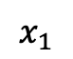
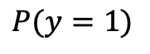
Neural Network
$$x_{1}$$
Input layer
$$P(y=1)$$
$$x_{2}$$
Output Layer
This is a multi-layer perceptron
Deep networks if h>2
Here, each node of layer L-1 is connected to every node in layer L. These layers are known as fully connected layers
There are other types of layers as well: convolutional layers, recurrent layers, transformer layers, etc.
Here, the 2-dimensional data is mapped into 4-dimensional space
Theoretically, one hidden layer (given enough width) can fit any equation
Hidden Layers (h)
Now let’s see MLPs in action!

Slide 18
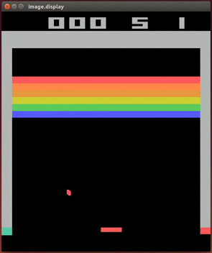
Applications of ML

Slide 19


Computer Vision

Slide 20

Computer Vision

Slide 21


Reinforcement Learning

Slide 22
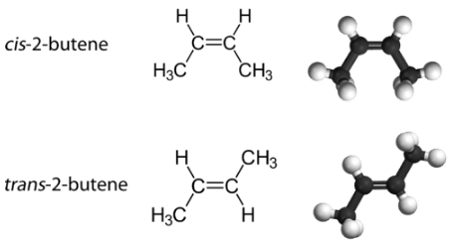
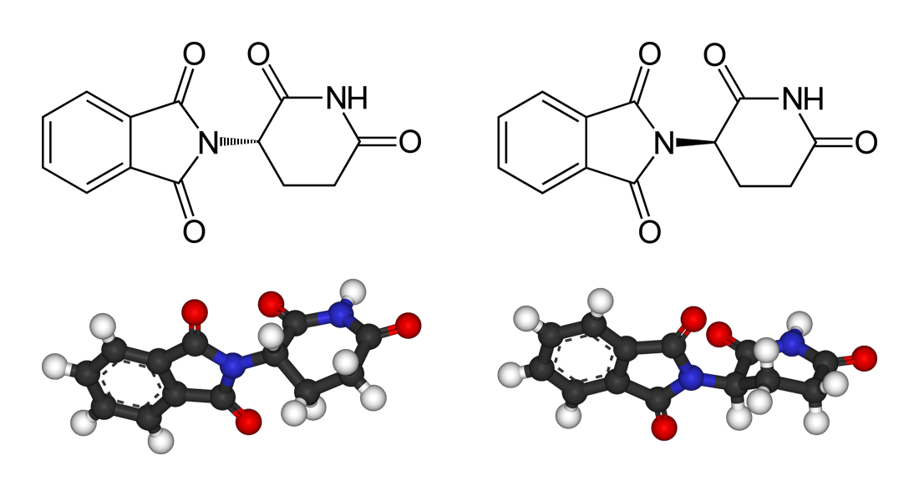

Reinforcement Learning
Protein folding is far more complicated
Thalidomide

Slide 23
Natural Language Processing
Translation
Question Answering
Conversation
Speech recognition
Summarization

